Slide 1
Session 5 The natural dynamics of infectious diseases

Slide 2
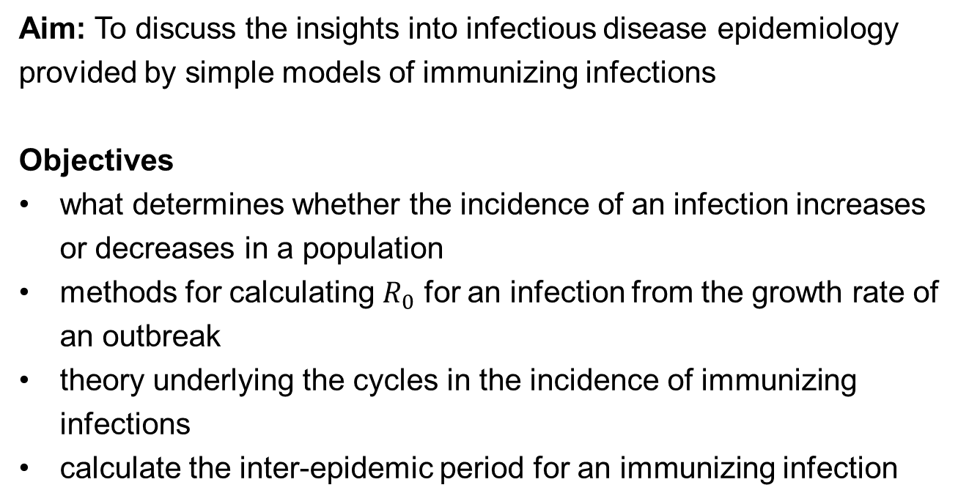
Aims and Objectives
Aim: To discuss the insights into infectious disease epidemiology provided by simple models of immunizing infections
Objectives
what determines whether the incidence of an infection increases or decreases in a population
methods for calculating $R_{0}$ for an infection from the growth rate of an outbreak
theory underlying the cycles in the incidence of immunizing infections
calculate the inter-epidemic period for an immunizing infection

Slide 3

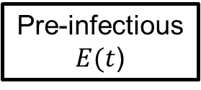

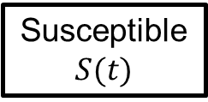

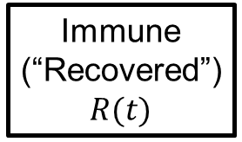
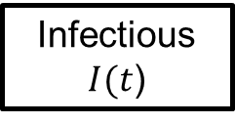
Structure of the model
$$βS\left(t\right)I(t)$$
$$fE(t)$$
$$rI(t)$$
Immune (“Recovered”)
$$R(t)$$
Susceptible $$S(t)$$
Pre-infectious $E(t$)
Infectious
$I(t$)
deaths
deaths
deaths
deaths
Simplest model to describe the long term dynamic of an infection assuming
Random mixing
Individuals not stratified by age and sex
Population size constant over time

Slide 4
Insights into the epidemiology of infections
which are derivable from the simple model
What determines whether or not the numbers of infectious individuals increases after an infectious person enters a totally susceptible population?
How fast might the number of infectious individuals increase and what can we infer from it?
Why does the incidence of an immunizing infection cycle over time?
What other factors lead to the epidemic cycles?
What inter-epidemic period might we expect to see?

Slide 5

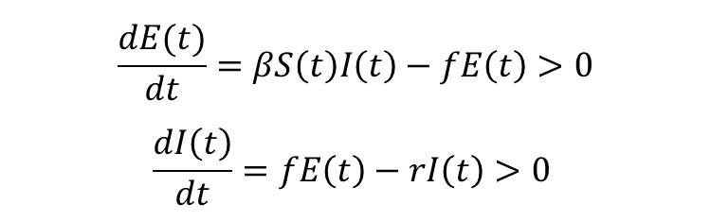
1. What determines whether or not the number of infectious individuals increases following the introduction of an infectious person into a totally susceptible population?
If the number of infectious individuals increases following the introduction of an infectious person into a totally susceptible population, then the rate of change in the number of pre-infectious and infectious individuals is “positive”
$$\frac{dE(t)}{dt}=βS\left(t\right)I\left(t\right)−fE\left(t\right)>0$$
$$\frac{dI\left(t\right)}{dt}=fE\left(t\right)−rI\left(t\right)>0$$
⇓
$$βS\left(t\right)I\left(t\right)>rI\left(t\right) or βS\left(t\right)>r$$
Notes:
The basic reproduction number is defined as the average number of secondary infectious individuals
resulting from one infectious following their introduction into a totally susceptible population.

Slide 6


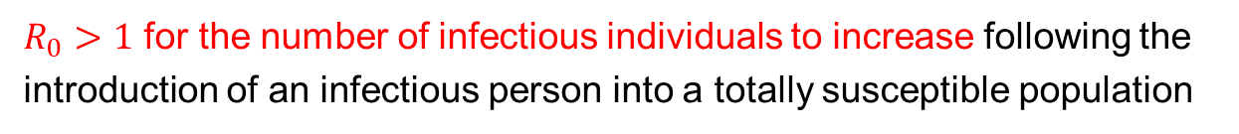

$R_{0}>1$ for an epidemic to occur
When the population is totally susceptible,
$$βS\left(t\right)>r ⇔ βN>r$$
Note that the basic reproduction number
$$R_{0}=βND=\frac{βN}{r}$$
$$βN>r ⇔ R_{0}>1$$
$R_{0}>1$ for the number of infectious individuals to increase following the introduction of an infectious person into a totally susceptible population

Slide 7
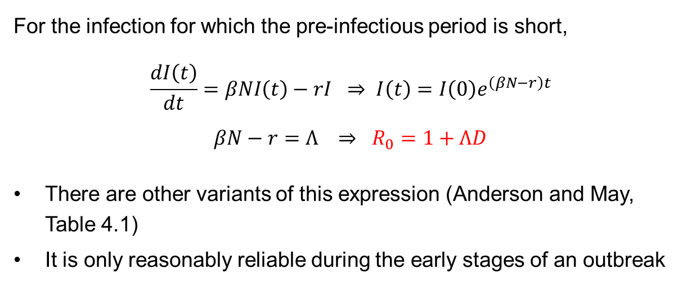
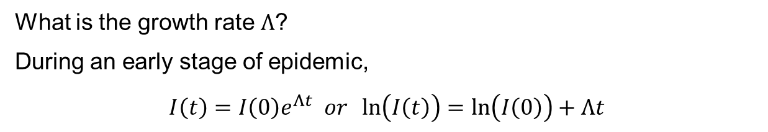
2. How fast might the number of infectious individuals increase and what can we infer from it?
What is the growth rate $Λ$?
During an early stage of epidemic,
$$I\left(t\right)=I\left(0\right)e^{Λt} or \ln\left(I\left(t\right)\right)=\ln\left(I\left(0\right)\right)+Λt$$
For the infection for which the pre-infectious period is short,
$$\frac{dI\left(t\right)}{dt}=βNI\left(t\right)−rI ⇒ I\left(t\right)=I\left(0\right)e^{\left(βN−r\right)t}$$
$$βN−r=Λ ⇒ R_{0}=1+ΛD$$
There are other variants of this expression (Anderson and May, Table 4.1)
It is only reasonably reliable during the early stages of an outbreak
Notes:
The drawback of this formula is that it is only reasonably reliable if the rate of increase in the prevalence of infection with the pathogen is calculated
during the early stages of an epidemic, and if the pathogen has only recently been (re)introduced into the population.

Slide 8
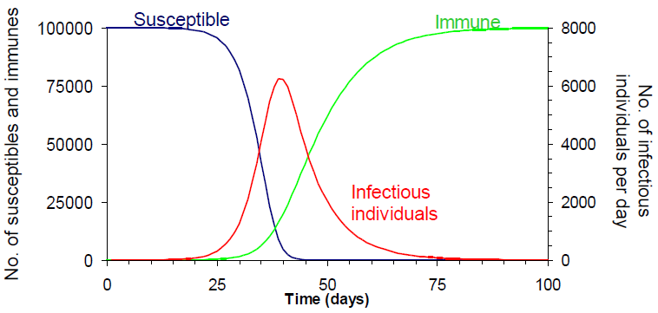
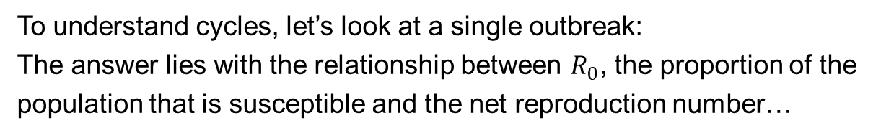
3. Why does the incidence of an immunizing infection cycle over time?
To understand cycles, let’s look at a single outbreak:
The answer lies with the relationship between $R_{0}$, the proportion of the population that is susceptible and the net reproduction number…

Slide 9
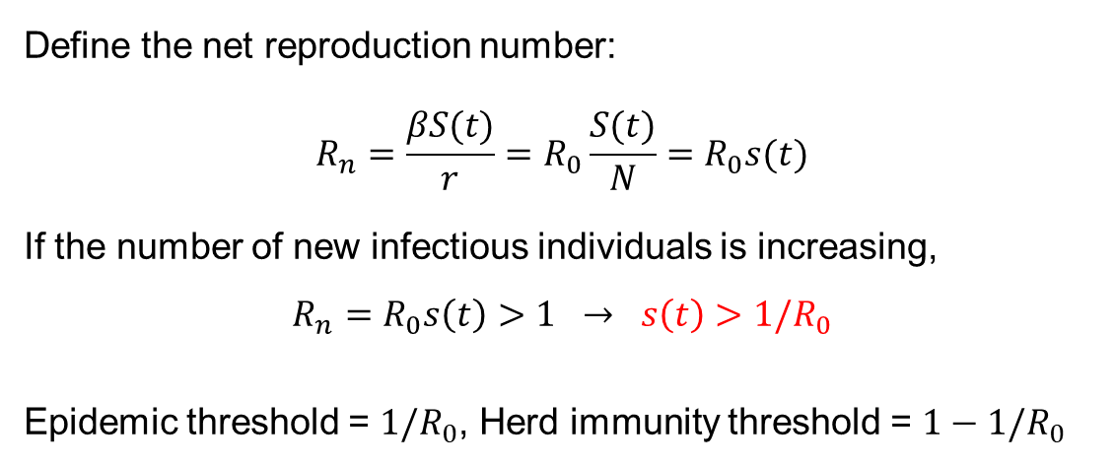
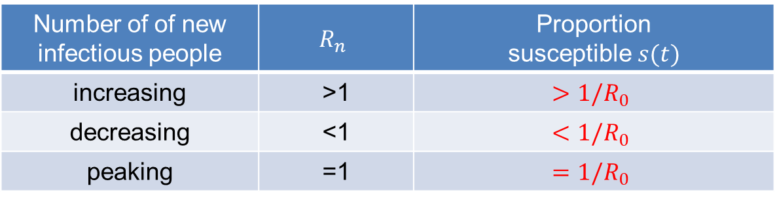
Net and basic reproduction numbers
Define the net reproduction number:
$$R_{n}=\frac{βS(t)}{r}=R_{0}\frac{S(t)}{N}=R_{0}s(t)$$
If the number of new infectious individuals is increasing,
$$R_{n}=R_{0}s\left(t\right)>1 → s\left(t\right)>1/R_{0}$$
Epidemic threshold = $1/R_{0}$, Herd immunity threshold = $1−1/R_{0}$
Number of of new infectious people | $$R_{n}$$ | Proportion susceptible $s(t)$
increasing | >1 | $$>1/R_{0}$$
decreasing | <1 | $$<1/R_{0}$$
peaking | =1 | $$=1/R_{0}$$
Notes:
The net reproduction number is defined as the average number of secondary infectious individuals
resulting from each infectious person in a given population, i.e. in which some individuals may be immune.
Without the entry of new susceptibles into the population, e.g. as a result of births, the proportion of susceptible
individuals would remain consistently below the threshold level and transmission would eventually cease.

Slide 10
Summary of what happens during an epidemic
New infectious individuals increases as there are sufficient susceptibles for each infectious person to leads to >1 infections
Proportion of susceptible individuals decreases
Once this proportion is sufficiently low, each infectious person leads to <1 infectious person, and the number of new infectious individuals starts to decrease
If no new susceptibles are born into the population, all the susceptibles are eventually depleted, and no new infections occur
Births provide a supply of new susceptibles into the population, fueling continued infections
→ Changes in the proportion of the susceptible population due to newborns
lead to epidemic cycles in immunizing infections

Slide 11
Explanation for the epidemic cycles for measles: relationship between the proportion susceptible and the new infectious

Slide 12
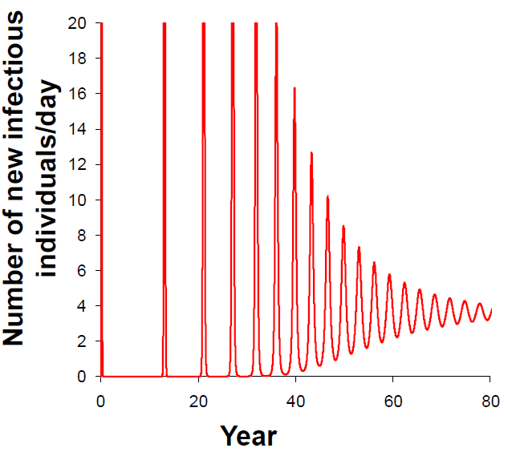
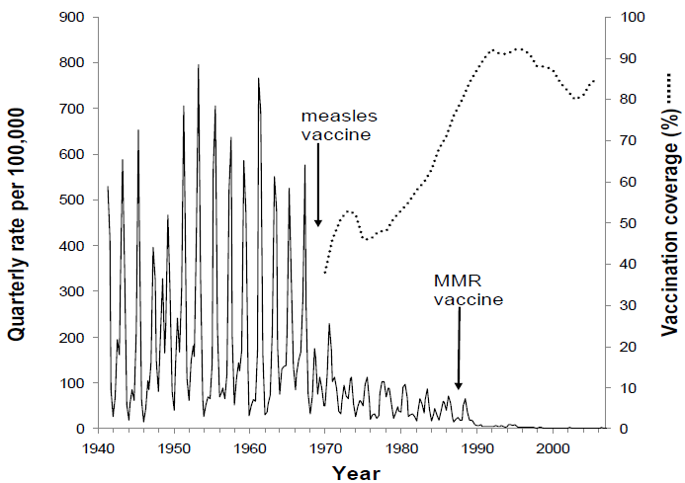
4. What other factors lead to the epidemic cycles?
Model predictions
Quarterly measles notifications in England and wales, 1941-2010
Comparison between the predictions of the simple model and observed data
There must be other factors which help to sustain the cycles!
Notes:
The damped cycles in the numbers of infectious individuals predicted by the model are inconsistent with the observed data
and has led to suggestions that other factors must be important in sustaining these cycles.

Slide 13
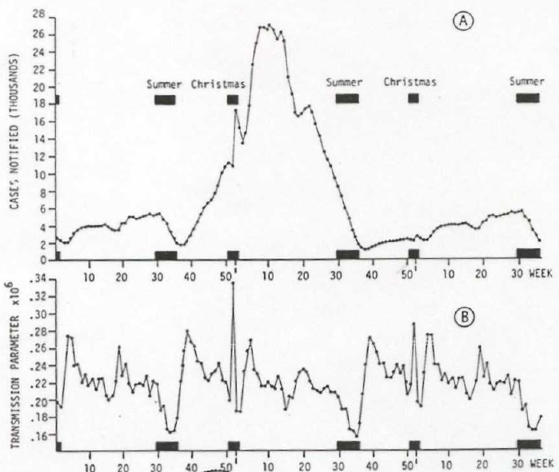
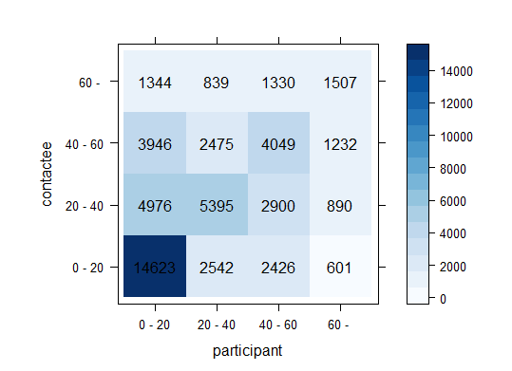
Factors for the epidemic cycles
Seasonality in transmission
Age-dependent mixing
Stochastic effects
a) average number of notified cases per week b) transmission parameters in UK, 1950~1965
contact matrix [Mossong et al. PLoS Med 2008]
Notes:
Analyses by Fine and Clarkson have found evidence for seasonal transmission in England and Wales,
occuring as a result of intense mixing between children during the school terms, and less intense mixing during the school holidays
These analyses used a model-based approach, calculating the transmission parameter in the simple mass action model
using the ratio between the number of cases observed in the UK in each week over the time period 1950-1977, and the number of susceptible individuals.

Slide 14
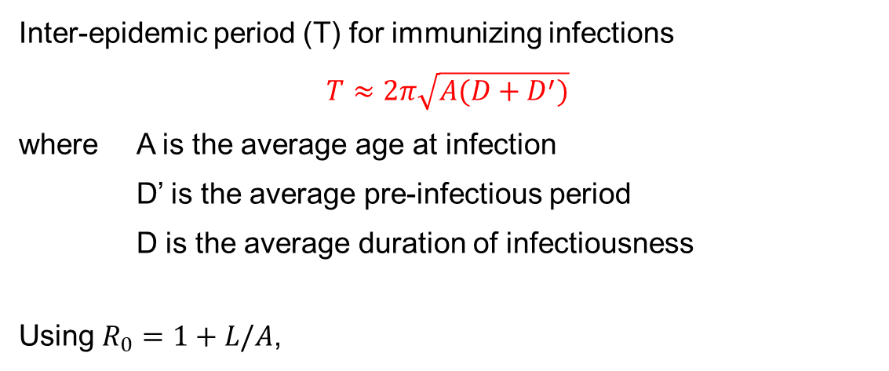

5. What inter-epidemic period might we expect to see?
Inter-epidemic period (T) for immunizing infections
$$T≈2π\sqrt{A(D+D^{′})}$$
where A is the average age at infection
D’ is the average pre-infectious period
D is the average duration of infectiousness
Using $R_{0}=1+L/A$,
$$T≈2π\sqrt{\frac{L\left(D+D^{′}\right)}{R_{0}−1}}$$
Quantifying the effect of vaccination:
→ reduction in prevalence of infectious cases
→ postpones infection until later in life
→ increases average age at infection
→ increases inter-epidemic period
Notes:
For some infections, the inter-epidemic period has been shorter than expected following vaccination:
For measles, for example, the inter-epidemic period after the introduction of vaccination has been shorter than that predicted
(see Anderson and May, 1992) and this has led to discussions that mixing between individuals may be age-dependent.

Slide 15
Comparison between the observed and predicted
inter-epidemic periods (Anderson and May, 1991)
 |  | Inter-epidemic period
Infection | Location | Calculated | Observed
Measles | England and Wales 1948-68 | 2 | 2
 | Aberdeen, Scotland 1883-1902 | 2 | 2
 | Baltimore, USA 1900-27 | 2 | 2
 | Paris, France 1880-1910 | 2 | 2
 | Yaounde Cameroon, 1968-75 | 1-2 | 1
 | Ilesha, Nigeria, 1958-61 | 1-2 | 1
Rubella | Manchester, UK 1916-83 | 4-5 | 3.5
 | Glasgow, Scotland, 1929-64 | 4-5 | 3.5
Mumps | England and Wales 1948-82 | 3 | 3
 | Baltimore, USA 1928-73 | 3-4 | 2-4
Polio | England and Wales, 1948-65 | 4-5 | 3-5
Smallpox | India, 1868-1948 | 4-5 | 5
Chickenpox | New York City, USA, 1928-72 | 3-4 | 2-4
 | Glasgow, Scotland, 1929-64 | 3-4 | 2-4
Scarlet fever | England and Wales, 1897-1978 | 4-5 | 3-6
Diphtheria | England and Wales, 1897-1979 | 4-5 | 4-6
Pertussis | England and Wales, 1970-82 | 3-4 | 3-4

Slide 16
Remarks
The above discussion relates to simple immunizing infections for which pre-infectious and infectious periods are short relative to the lifetime of individuals, such as measles, mumps and rubella
The same logic cannot be applied for infections which
do not confer immunity against re-infection
have long incubation periods: for TB, the time interval between infection and disease may be as long as a lifetime, and conditions may change during this time.

Slide 17
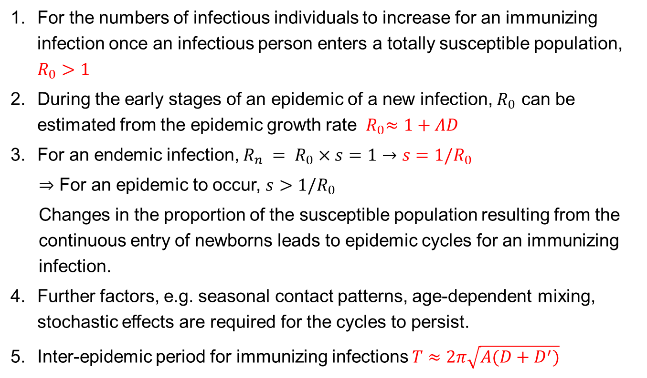
Summary
For the numbers of infectious individuals to increase for an immunizing infection once an infectious person enters a totally susceptible population, $R_{0}>1$
During the early stages of an epidemic of a new infection, $R_{0}$ can be estimated from the epidemic growth rate ${ R}_{0}≈1+ΛD$
For an endemic infection, $R_{n} = R_{0}×s=1→s=1/R_{0}$
$⇒$ For an epidemic to occur, $s>1/R_{0}$
Changes in the proportion of the susceptible population resulting from the continuous entry of newborns leads to epidemic cycles for an immunizing infection.
Further factors, e.g. seasonal contact patterns, age-dependent mixing, stochastic effects are required for the cycles to persist.
Inter-epidemic period for immunizing infections $T≈2π\sqrt{A(D+D^{′})}$

